Slide 1

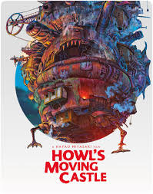
Maddi Andrews and Chelsea Corner

Slide 2
Contents
Introduction………………………………………………………………….1
Impact of language and structural choices on shaping interpretations……………………………………………………………...2
The ways ideas are represented……………………………..………3
The ways attitudes are represented……….………………………4
The interplay between imaginative, interpretive and persuasive techniques……………………………………………………5
The change in responses over time………………………………..6
Reader/viewer positioning…………………………………………….7
The influence of anime on text response………………………8
Intertextuality……………………………………………………………….9
Conclusion……………………………………………………………………10

Slide 3
Introduction
Symbolism relates to the use of symbols to signify and represent ideas and qualities by giving them symbolic meanings that are different from their literal sense. Symbolism can take different forms. Generally, it is an object representing another to give it an entirely different meaning that is much deeper and more significant. Howl’s Moving Castle, a speculative fiction film released in 2004, directed by Hayao Miyazaki and produced by Studio Ghibli ,based on the original novella. The film encapsulates a wide range of symbolism and objects of symbolic value, in particular the representation of love, colour and superiority featured in the Mise-en-scene. Mise-en-scene relates to the arrangement of the scenery, props, etc. on the stage of a theatrical production or on the set of a film. Howl’s Moving Castle focusses on the protagonist Sophie and her uneventful life at her late father's hat shop, but all that changes when she befriends wizard Howl who lives in a magical flying castle and her life takes many exciting turns. The film highlights ideas that would be held in high regard with respect to a critique of both militarism and nationalism, and displays similar ideas featured throughout Junko Morimoto’s, My Hiroshima. The Film also offers an allegorical criticism of War its self, as the film is set during no particular war. The Mise-en-scene explores all this through technical codes such as positioning/placement, colouring and the symbolic code of setting and all create the basis for a resistant reading towards the idea of militarism and nationalism.

Slide 4
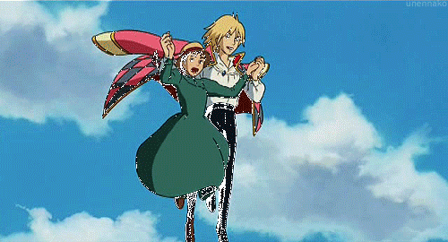
Mise-en-scene

Slide 5
Impact of structural choices on shaping interpretations
The structural choices, such as positioning and placement present in the Mise-en-scene, creates the interpretation that Howl is superior to, or more advanced than Sophie. This is shown through the positioning of Sophie below him, suggesting she is inferior. Howl is also holding Sophie up – which suggests that without him - Sophie would be hopeless and will fall.

Slide 6
The ways ideas are represented
Ideas are represented through major theories and ideologies, such as, pacifism, nationalism, post-modernism and militarism.
Some ideas can also be represented through symbolism, colour symbolism, positioning and placement, and setting etcetera.
Regarding our mise-en-scene, the idea of love is represented symbolically, as they’re walking in the air - “falling” in love.

Slide 7
The ways attitudes are represented
Attitudes can be represented through the use of many conventions, in regards to our Mise-en-scene, the attitudes are displayed through the use of facial expression
Howl has a peaceful facial expression suggesting that his attitude towards the situation is a lot more calm.
Sophie, however, has a much more distressed facial expression suggesting she is not at ease with the situation.

Slide 8
The interplay between imaginative, interpretive and persuasive techniques
Howl’s Moving Castle utilises a large range of techniques all aiding with the construction of a critique towards militarism and nationalism, as well as adding symbolic value.
These techniques are largely imaginative, interpretive and persuasive that all compliment each other in creating a critique
These include; the persuasive techniques of anecdote and the use of appeal to influence the readers emotions; the interpretive techniques of environment and flashback; and the imaginative techniques of sympathy and empathy

Slide 9
The change in responses over time
The response to a text is largely aided by the current social and political events at the time. In 2004, when the film was first released, many people would not have understood the deep underlying message, however, with the increasing amount of war and conflict as time went on, more people would have grown to understand the true meaning of the text and thus influencing their response.
In regards to our Mise-en-scene, the response may very depending on the type of viewer. For some younger viewers the symbolic value of the event taking place may not be noticed, however for some more mature viewers, the symbolic representation of falling in love may be very clear.

Slide 10
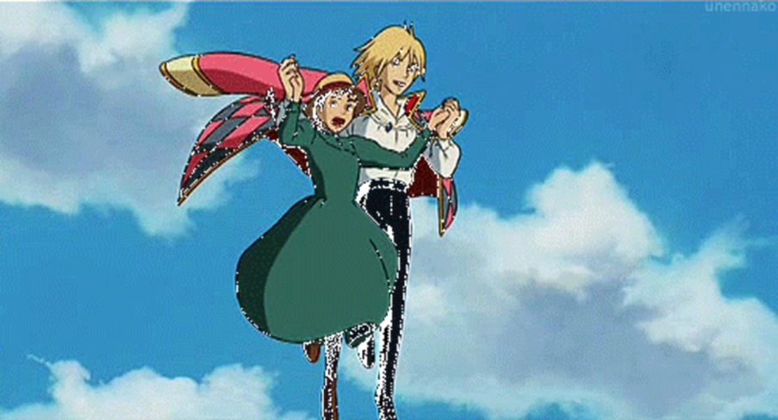
Viewer positioning
In regards to our mise-en-scene, and the symbolism of love, viewers are positioned to feel that all women need men to support them, and the understanding that women are inferior.
Viewers are also positioned to see that Sophie is petrified, which is symbolic, as it results in her being scared of love.

Slide 11
The influence of anime on text response
The use of anime allows the strong message and meaning behind the text to be hidden in a family friendly animation which may seem, to some, like a romantic love story between a young women and the boy of her dreams.
The use of anime also allows our particular Mise-en-scene to be open for interpretation as it appears, on the visual front, to be quite innocent with no real meaning rather than its symbolic representation of falling in love – walking on air.

Slide 12
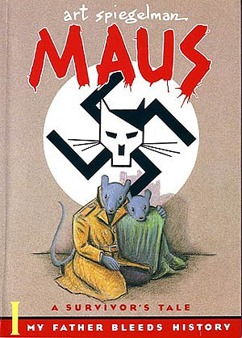
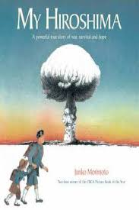
Intertextuality
Junko Morimoto – My Hiroshima
My Hiroshima is a new edition of a contemporary classic children’s book about war, survival and hope - and what happened to one young girl when an atomic bomb was dropped on her city.
Art Spiegelman – Maus
Maus is a graphic novel by American cartoonist Art Spiegelman, serialized from 1980 to 1991. It depicts Spiegelman interviewing his father about his experiences as a Polish Jew and Holocaust survivor.

Slide 13
Conclusion
In conclusion, Howl’s Moving Castle, directed by Hayao Miyazaki and produced by Studio Ghibli, is a film that encapsulates a wide range of symbolism and objects of symbolic value, in particular the representation of love, colour and superiority, featured in the Mise-en-scene of Sophie and Howl, walking in the air, ‘falling in love’. Viewer’s are positioned to gain the understanding that women are positioned to be inferior and that men are needed to support women and to ‘hold them up’. Junko Morimoto’s children’s book, My Hiroshima, parallels Howl’s Moving Castle’s ideas of pacifism, nationalism, post-modernism and militarism – which in effect, changes the public’s responses over time regarding the film.
Thank you for listening!

